Slide 1
Predicting Sleep Disorders
ADS 503
Vannesa Salazar, Diana Fay Arbas, Joel Day

Slide 2
Executive Summary
Data
Problem
Goal
Resolution
Sleep Health and Lifestyle Dataset:
Unlock sleep insights with the Sleep Health Dataset
Lack of sleep can hurt our cognitive functions, mood, and physical performance.
Use predictive modeling to identify who has a sleeping disorder.
The model will allow for early detection, appropriate intervention, and improved management of sleep disorders.

Slide 3
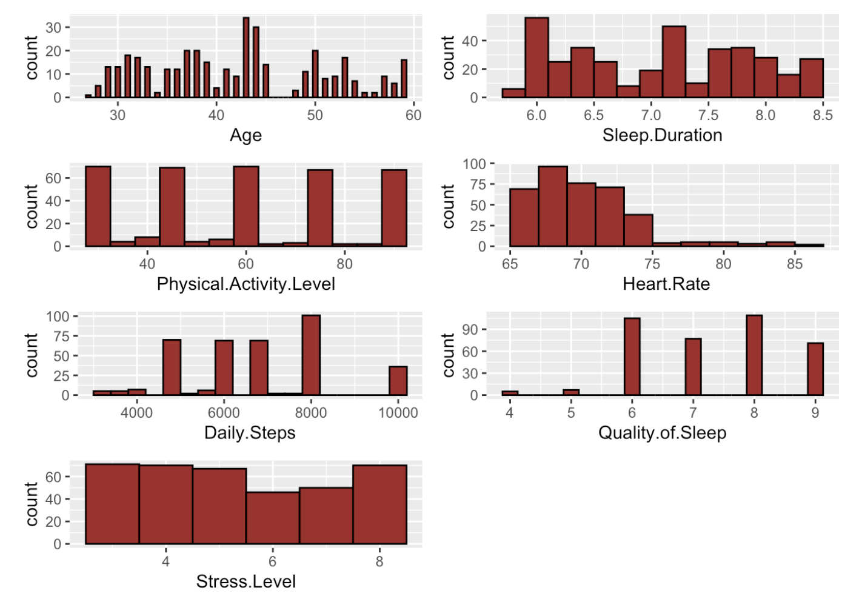
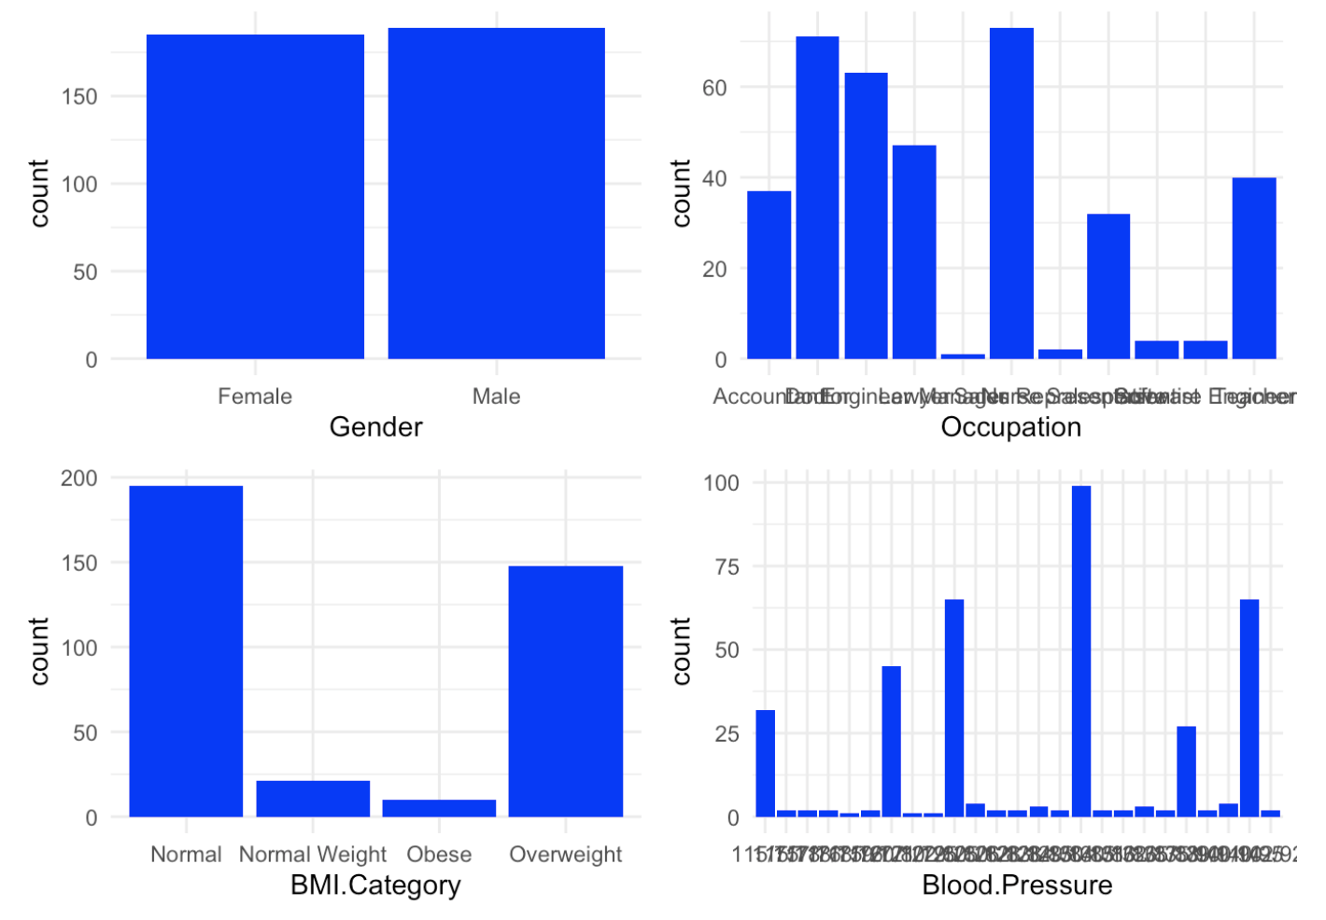
Exploration

Slide 4
Project Timeline
Model Creation: Nine total models were built
Select Final Model: used for Sleeping Disorder predictions
Data obtained from Kaggle.com
Data Exploration
Model Performance Evaluation

Slide 5
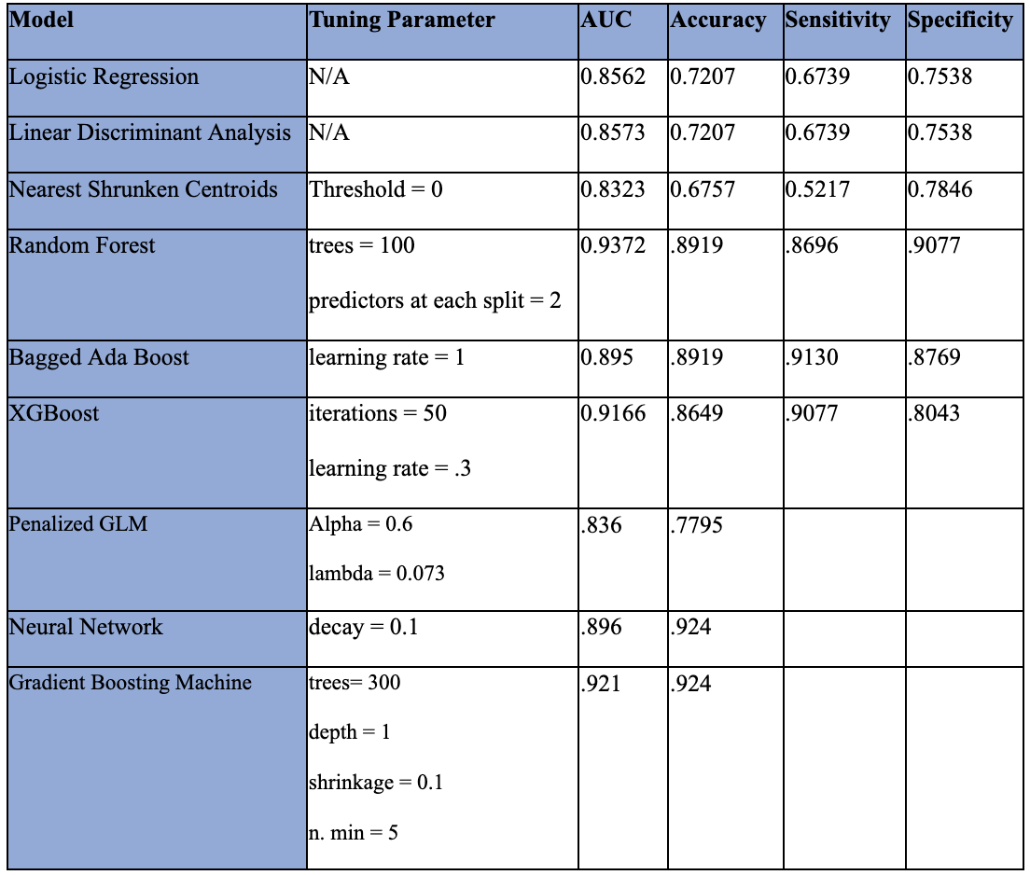
Final Model Performance
Best Model: Random Forest
The three most Important predictors in the Random Forest Model: age, daily steps, and physical activity level.
Except for gender, all point to as you stay more active you have sleep better.

